Slide 1

Online Beauty Parlour and Management System
IACSD PG-DAC SEPT 2020
Presented by: Anshul Bahadure 2015
Vaishnavi Tambe 2204
Guided By: Mr. Chetan Pardeshi

Slide 2
Introduction
Beauty parlour management system is a web-based salon management application with appointment scheduling functionality.
In this system user can sign-up and sign-in to the salons and can choose the services can make appointment online.
In this system beauty parlour owner can make their account online and give details of the services they offer and also describe the stylist information.

Slide 3
Scope
It connects clients, salons and stylists in online community allowing user to browse salon and stylists and book or cancel appointments.
The system is highly flexible one and is well efficient to make easy interactions with the client.
There is a huge amount of demand for grooming across all age group and especially with young boys and girls.

Slide 4
Problem Statement
It gets really hard to maintain the records of appointment booking and clients and then keep. Hence this system is proposed to overcome the flaws of the existing system and giving power to the admin of the salon so that he/she will be able to manage the salon easily.

Slide 5
Aims & Objectives
Specific goals are: -
To produce a web-based system that allows the admin to add Services, clients and provide functionalities to its role.
To ease salon by providing different functionalities to it.
To ease clients to help them in their appointment booking to add and track their appointment efficiently.

Slide 6
Technology Used:
The application will use Node js, React, Firebase Database, Redux, Antd library, JavaScript, jest and CSS as main web technologies.

Slide 7
Features
It provides login for the users.
Admin controls the system.
User can book the appointment by providing their details along with the services they want to get.

Slide 8
Database:
Firebase Real-Time Database is used in this System.
It is a cloud-hosted database. Data is stored as JSON and synchronized in real-time to every connected client. It Stores and sync data with our NoSQL cloud database. Data is synced across all clients in real-time, and remains available when the app goes offline.

Slide 9
Database Schema:
Appointment Schema
User data Schema
Services Schema
Authentication schema

Slide 10
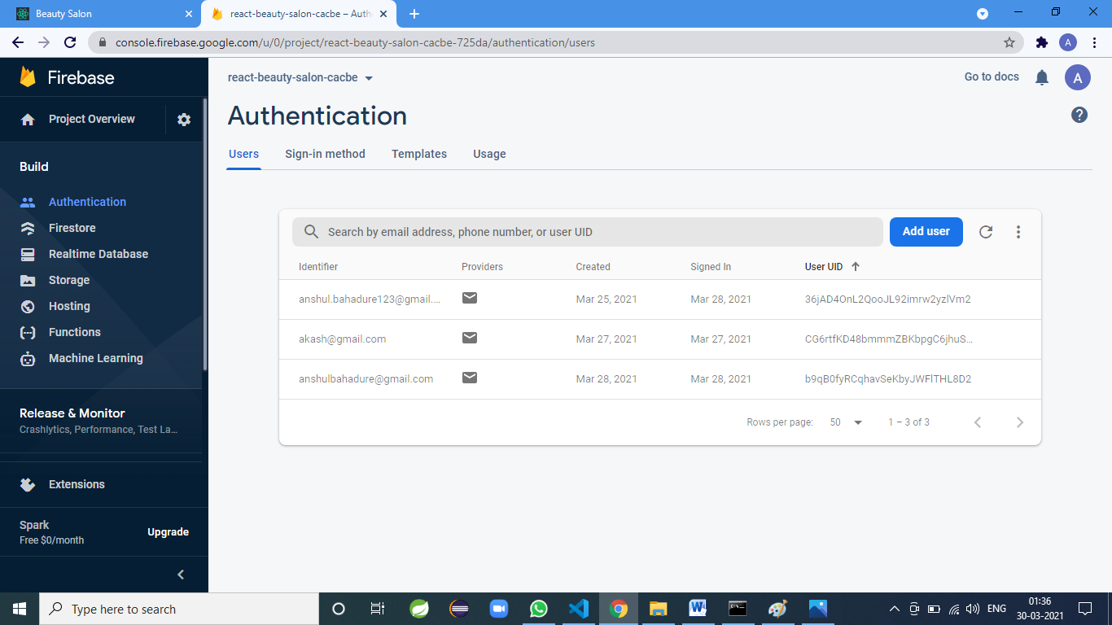

Slide 11
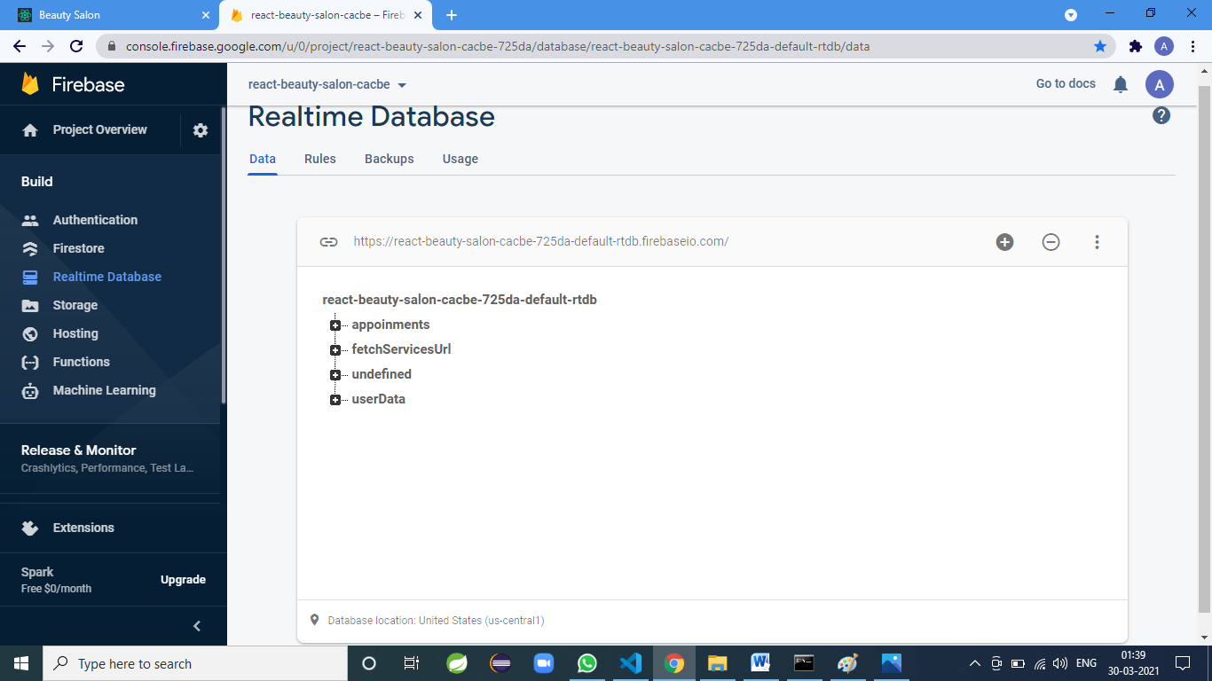

Slide 12
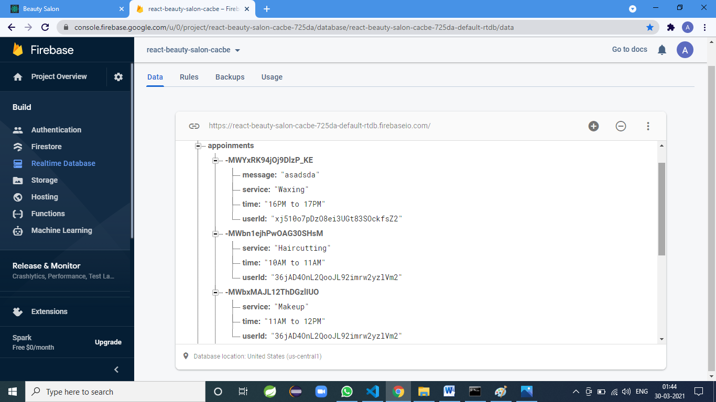

Slide 13
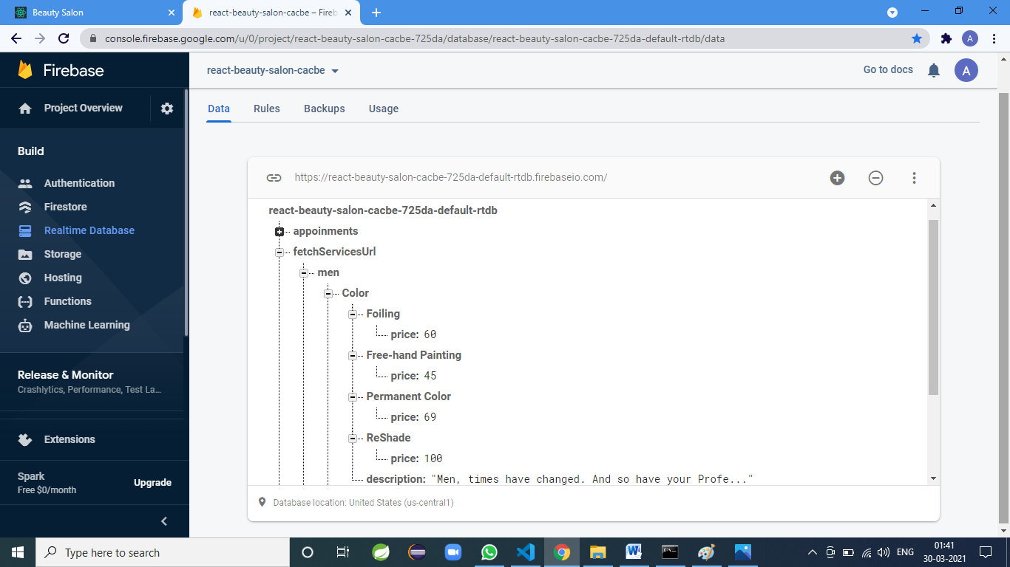

Slide 14


Slide 15


Slide 16
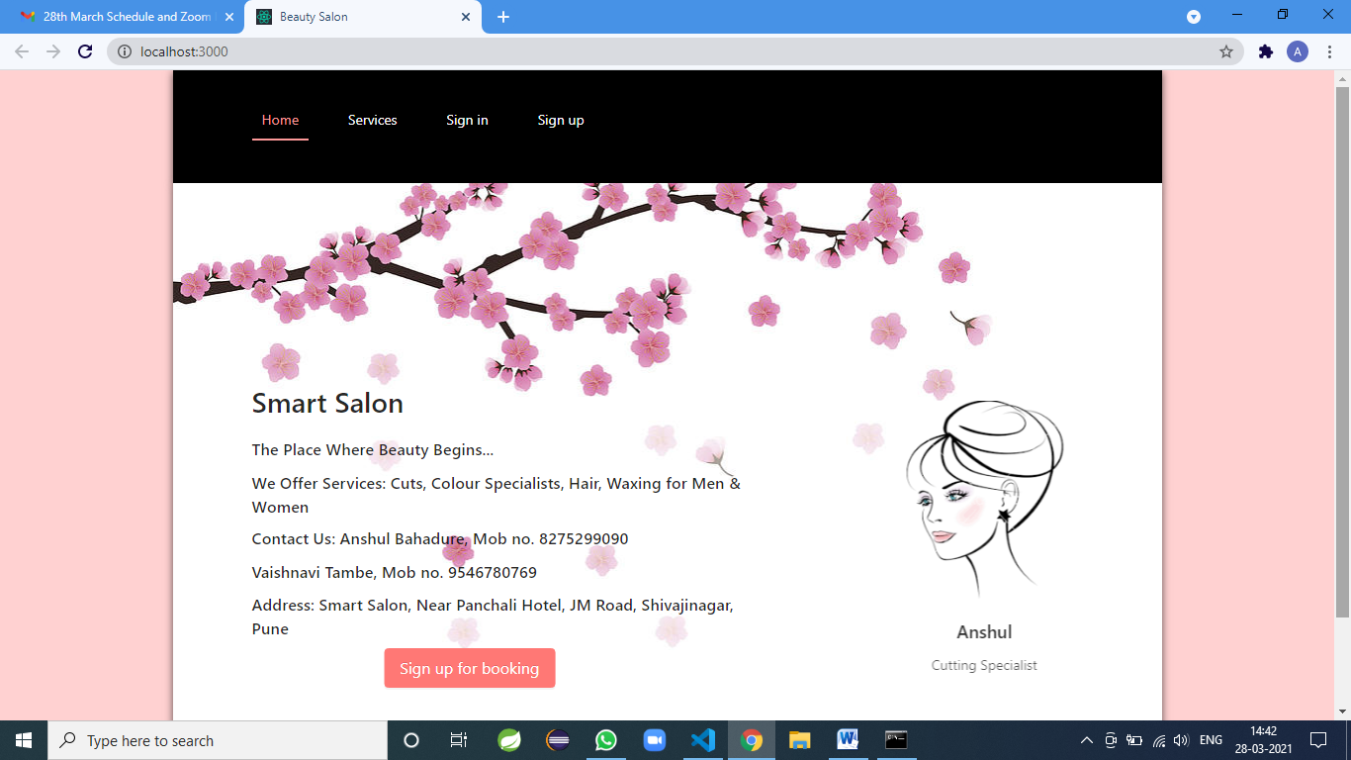
Results

Slide 17
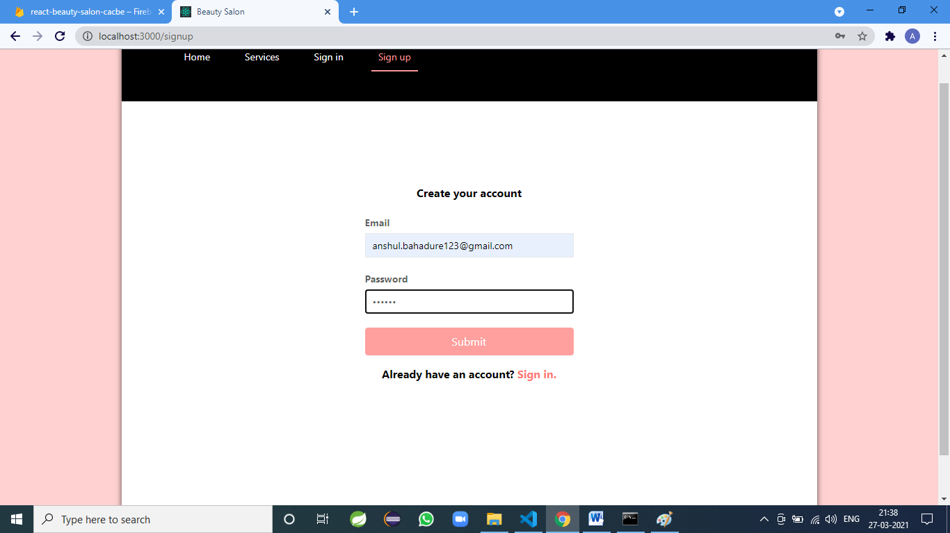

Slide 18
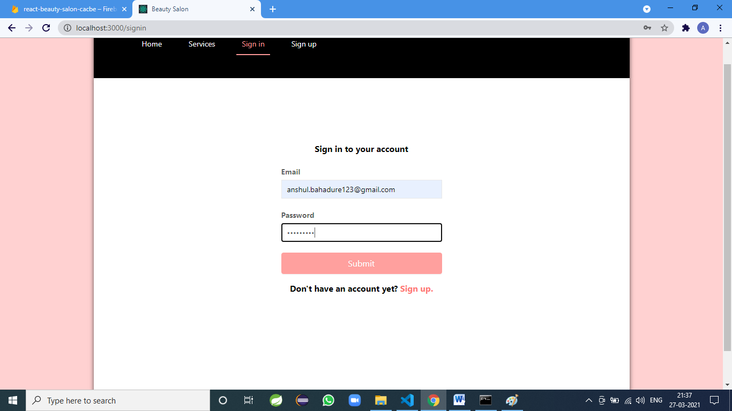

Slide 19
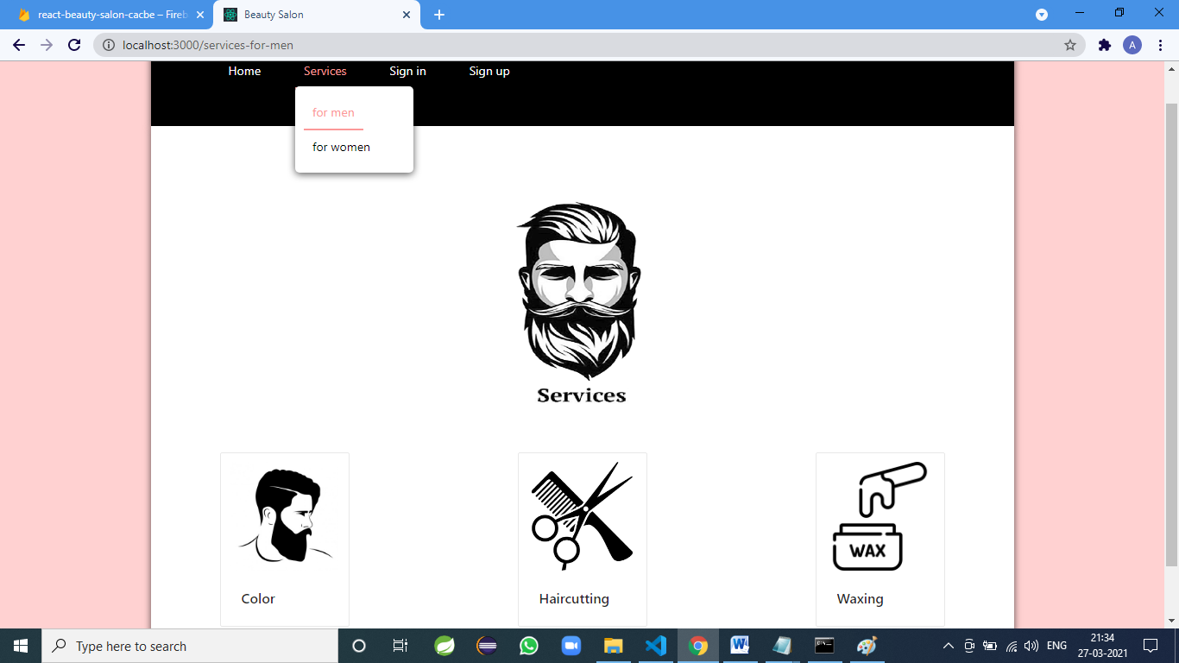

Slide 20
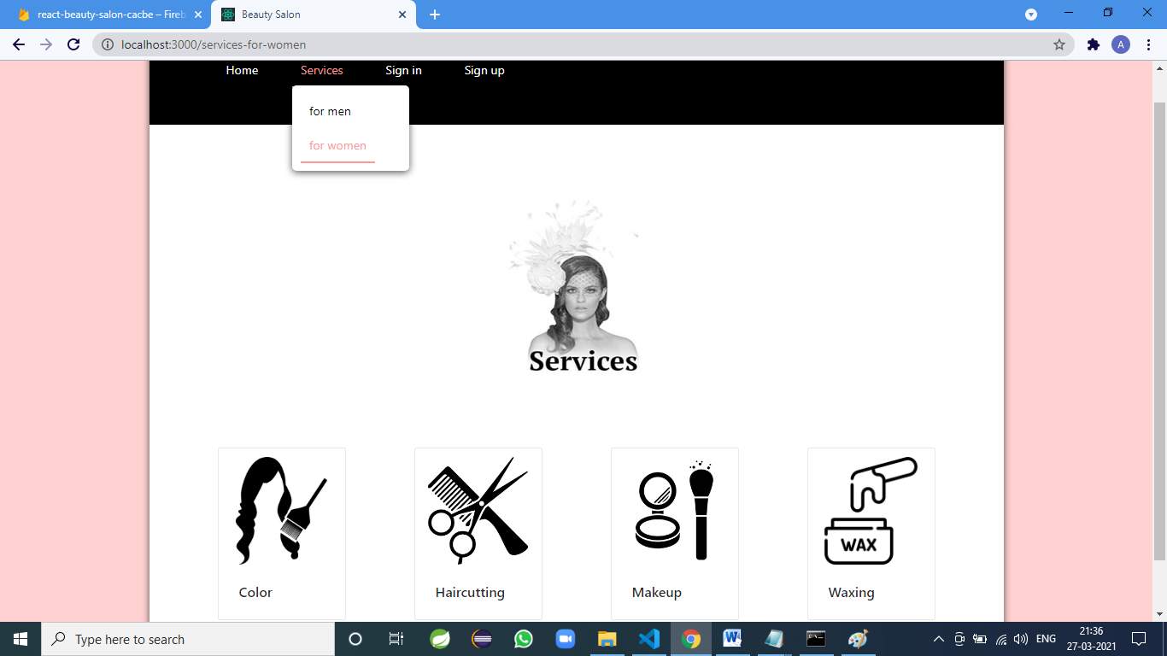

Slide 21
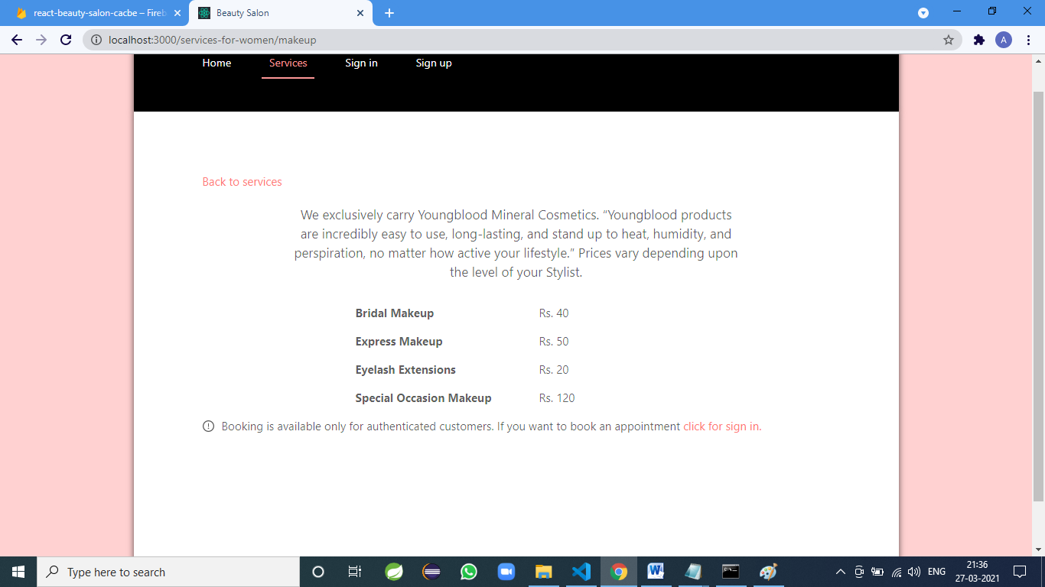

Slide 22
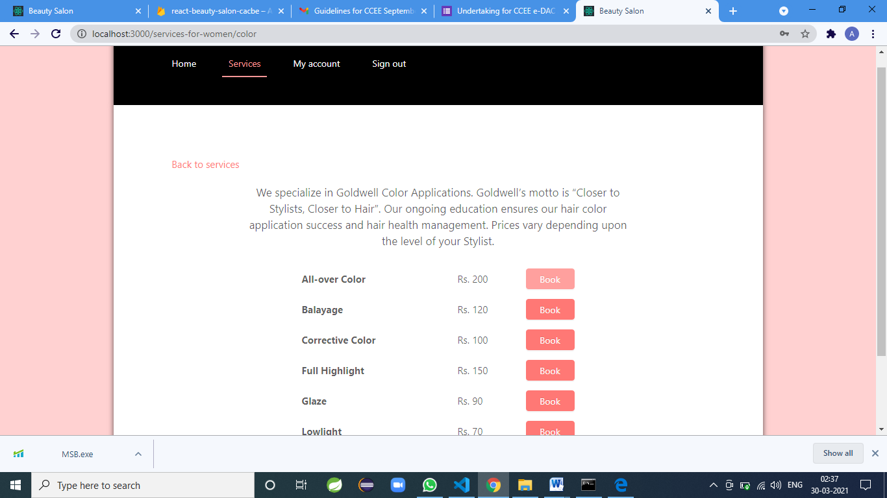

Slide 23
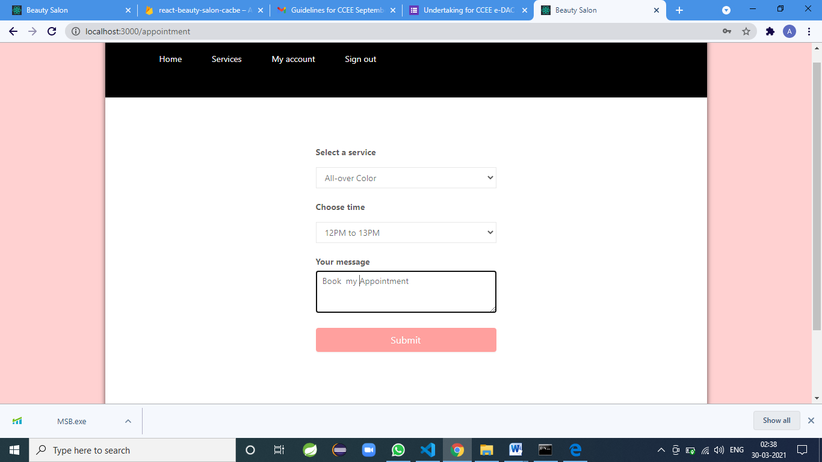

Slide 24
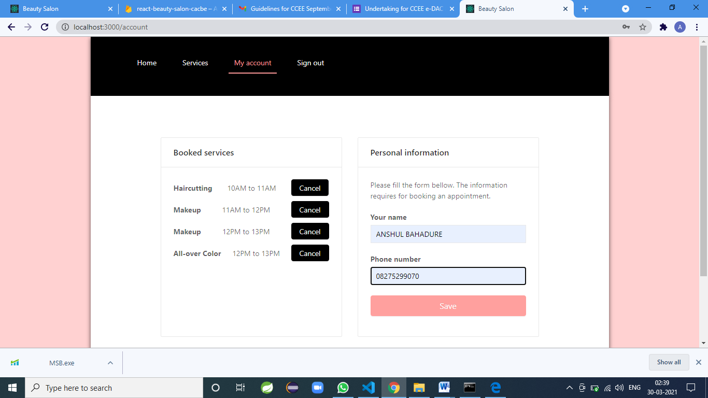

Slide 25
Conclusion
This app is available for books your order anytime and anywhere and books your appointment for service online and use the mode of payment in cash payment (Cash on Delivery).
User can access services and functionalities from the salon anywhere and anytime for their own comfort.

Slide 26
Future Scope
This project can be enhanced further by adding Searching Option for various Salons, adding booking with Offers, Giving Festival Discount, and online payment facility for the members to reduce the extra work of the admin.

Slide 27
References
[1] Nindito, H. and Alianto, H., 2019, August. Prototype Development For Online Reservation System in Barbershop and Salon Industry. In 2019 International Conference on Information Management and Technology (ICIMTech) (Vol. 1, pp. 58-61). IEEE.
[2] JAYAWARDENA, GJVPSO. "SALON MANAGEMENT SYSTEM FOR “SALON NIROSHA”." PhD diss., 2017.
[3] Chai, Annie, and Chuah Chai Wen. "SHEARS INC. Salon Management System." JOIV: International Journal on Informatics Visualization 1, no. 4-2 (2017): 246-249.
[4] Ang, B.K.M., 2013. Beauty Salon Management System (Doctoral dissertation, Tunku Abdul Rahman University College)..
[5] Putra, Kadek Dharma Krisna, I. Nyoman Piarsa, and I. Made Sukarsa. "Geographic Information System for Booking Beauty Salon and Barber Shop with an Android-Based ECRM Approach." Scientific Journal of Informatics 7, no. 1 (2020): 52-65.

